Slide 1
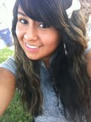
Hi my name is…
RACHEL
Medina!☺

Slide 2
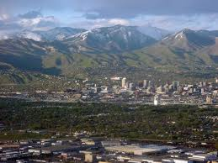
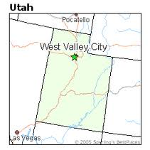
Where I am from
I am from West Valley City, Utah.

Slide 3
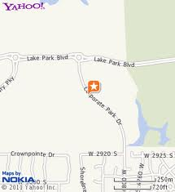
What Jr. high I attended.
I attended Monticello Academy for about 6 years.
It is located in Lake Park.

Slide 4
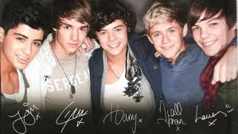
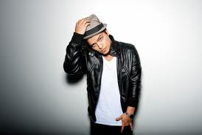
What kind of music I enjoy.
I enjoy pretty much all types of music.
My favorite artist would have to be Bruno Mars!<3
I have more than one favorite bands.
They are One Direction and Parachute.

Slide 5
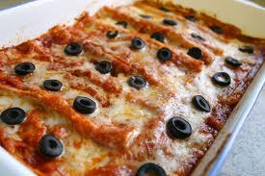
My favorite foods.
I love lots of foods but my favorites would have to be any type of pasta, cheese enchiladas and Trix cereal.

Slide 6
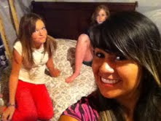
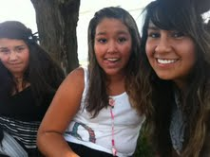
Hobbies.
My favorite hobbies are playing soccer, hanging out with friends and listening to music.

Slide 7
My goals in school.
My goal in school is to graduate at Ames with good grades and continue on to college. Then also graduate from there.
I don’t know what college I would like to attend yet.

Slide 8
EL FIN!☺

