Slide 1
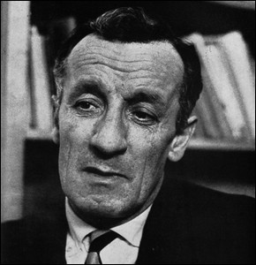
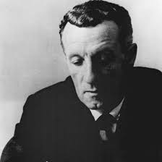
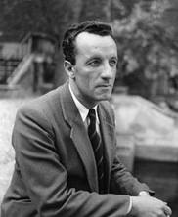
Maurice Merleau-Ponty
By Rachel Medina, Sam Miller and Nolan Richter

Slide 2
Biography
Born March 14, 1908 in Rochefort, France
Died May 1961 in Paris
Educator, philosopher, political scientist, academic author, editor, and journalist
Went to Ecole Normale Superieure in 1930
Lost his father in WW1
Served in the infantry in WW2
Elected Chair of Philosophy in 1952 until his death
Began teaching high school philosophy in 1930

Slide 3
existentialism
Def: (noun) a philosophy that emphasizes the uniqueness and isolation of the individual experience in a hostile or indifferent universe, regards human existence as unexplainable, and stresses freedom of choice and responsibility for the consequences of one’s act -Free Dictionary
In short, what you perceive is unique

Slide 4
philosophy
http://www.youtube.com/watch?v=476isumfBNY&safe=active
This video is just describing his philosophy of existentialism

Slide 5
philosophy (cont.)
Basically his whole philosophy was about how you perceive the world
Even if you and I both know that the wall is green, our greens may be different, but we still have been taught that it’s green
We make names for things and maybe everyone perceives it the same, but maybe it’s not

Slide 6
Bibliography
plato.stanford.edu
www.biography.com › People/entries/merleau-ponty/
www.egs.edu/library/maurice-merleau-ponty/biography

Slide 7
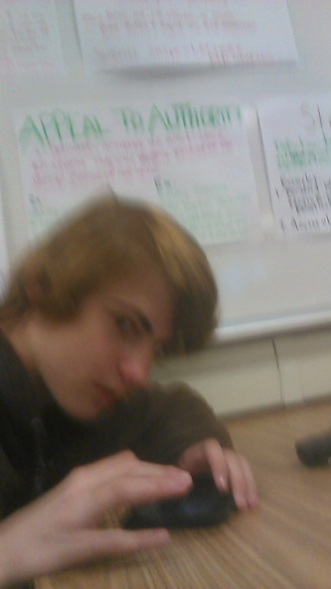
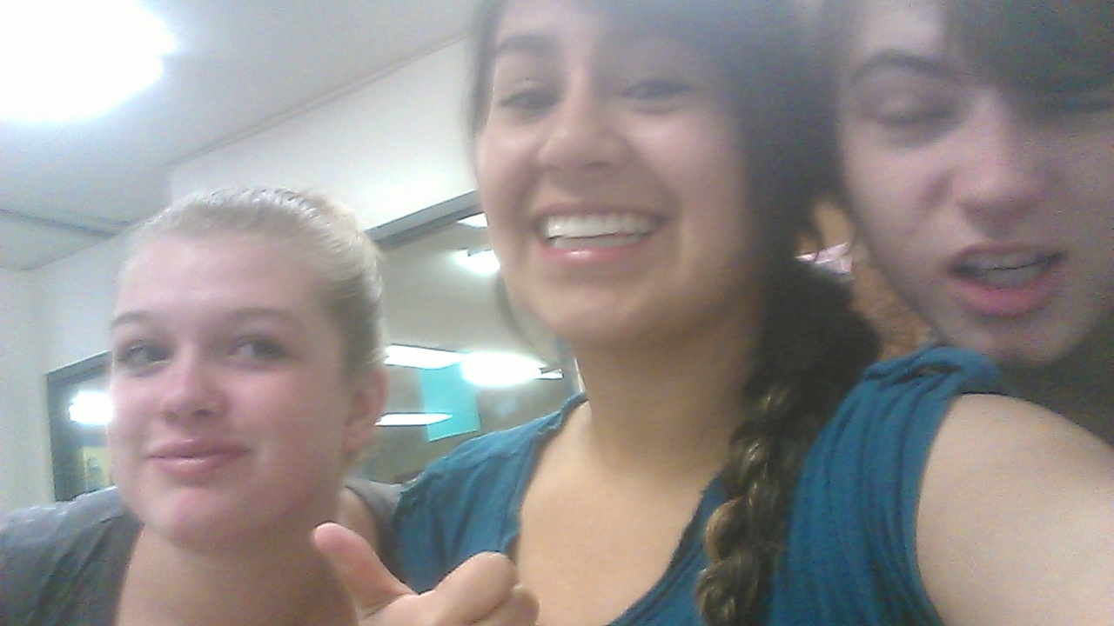
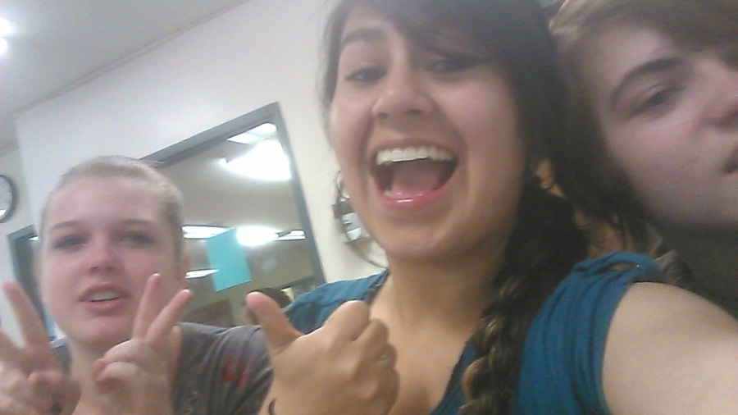
Thanks for Watching!☺

