Slide 1
Computer parts ☺
By Rachel Medina

Slide 2
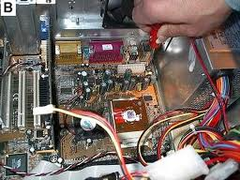
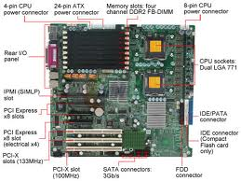
Motherboard
The arrangement of the computers components and circuitry

Slide 3
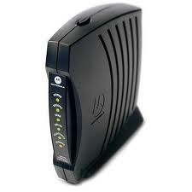
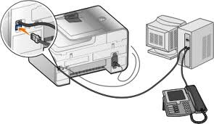
Modem
A device connecting the computer to the telephone line

Slide 4
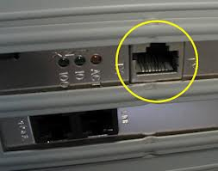
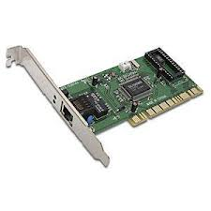
Network card
A network interface card is device that connect to the computer then to a network

Slide 5
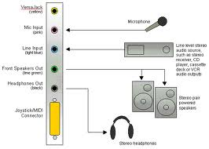
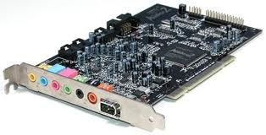
Sound card
A device that can be slotted into a computer for the use of audio components for applications.

Slide 6
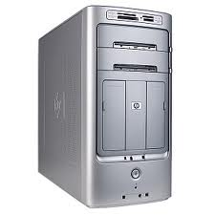
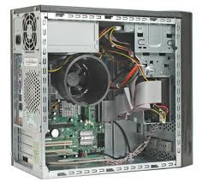
Case
A computer case is the enclosure that contains most of the components of a computer.

Slide 7
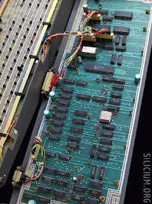
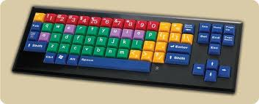
Keyboard
A panel of keys that operates a computer mostly on the monitor.

Slide 8
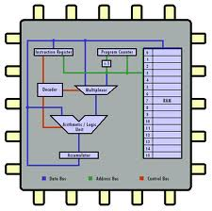
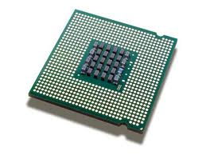
CPU
Central processing unit- type of processor that does most of data processing.

Slide 9
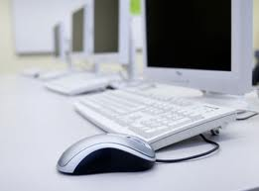
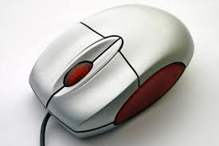
Mouse
a mouse is a hand-operated device that controls a cursor on your computer screen

Slide 10
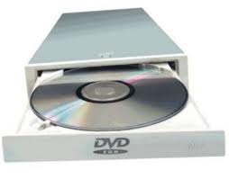
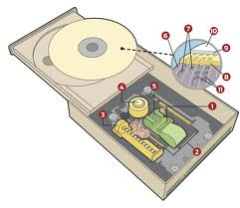
CD rom CD Rom/DVD/ CD
compact disk that is used with a large amount of digital information.

Slide 11
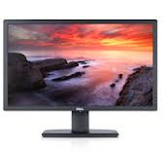
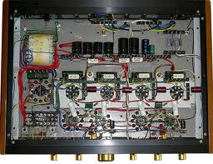
Monitor
a device that displays signals on a computer screen

Slide 12
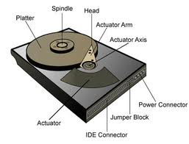
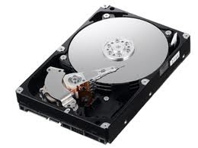
Hard drive
A self-contained storage device containing one or more hard disks, inside a sealed unit.

Slide 13
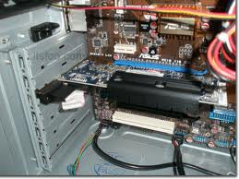
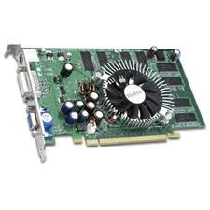
Video card
printed circuit board controlling output on the screen

Slide 14
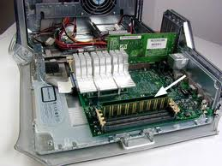
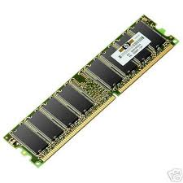
Ram
RAM -for random access memory, a type of computer memory that can be accessed randomly.

Slide 15
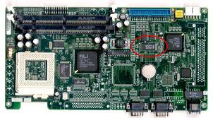
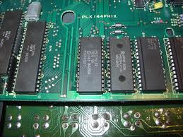
Rom
A place where you can store your information.

Slide 16
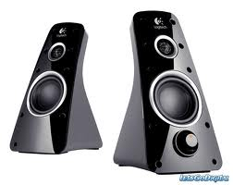
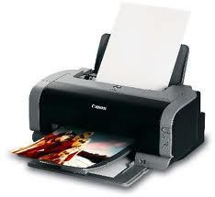
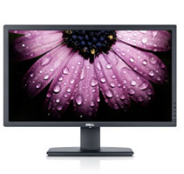
Output devices-transfers data out of the computer.
Speakers
Printer
Monitor

Slide 17
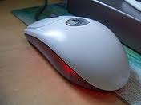
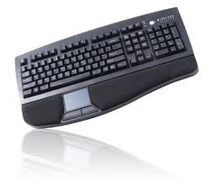
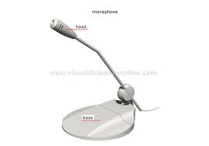
Input device-transfer data into the computer.
Mouse
Keyboard
Microphone

Slide 18
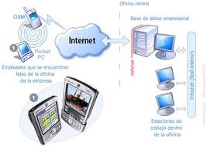
Software
The programs and other operating information used by a computer

Slide 19
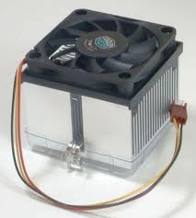
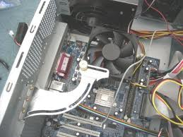
Fan
Keeps the parts in the case from getting to hot.

Slide 20
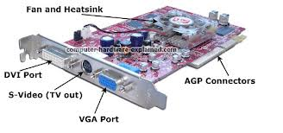
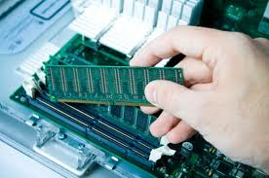
Graphics card
Graphics card is a card that generates outputing images to a display.

Slide 21
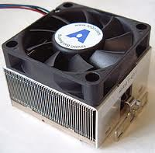
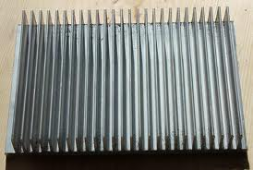
Heat sink
A region or structure that can absorbs heat so it wont over heat.

