Slide 1
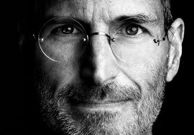
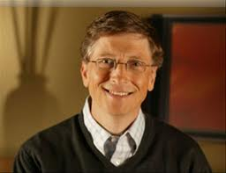
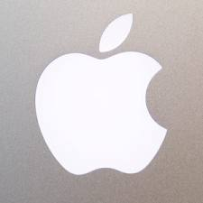
Bill Gates & Steve Jobs
By Rachel Medina
November 27,2012
A2

Slide 2
Outline
1.Bill Gates
1a.Early life
2b. Life in Microsoft
2.Steve Jobs
2a.Begginging of life
2b.Life in Mac
2c.End life

Slide 3
Bill Gates October 28, 1955 born in Washington
He was born to William and Mary Gates
Gates was Scot, English and German
Bill has two sisters Libby and Kristi
His parents planned for him to have a law degree when he was older.
When he was 13 he enrolled to Lakeside school a prepatory academy.
He took an interest in programming the GE system.

Slide 4
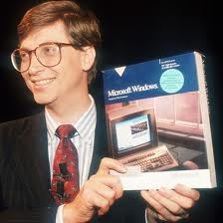
At age 17 he called to make traffic counters on Intel 8008.
He scored 1590 out of 1600 on his SAT then attended Harvard college in 1973.
Allen at MITS in Albuquerque in November 1975. They named their partnership "Micro-Soft“
Microsoft launched its first version of Microsoft Windows on November 20, 1985.
Gates is the former chief executive and current chairman of Microsoft, the world’s largest personal-computer software company
Also Gates continues his philanthropy
In 1987, Bill was listed as a billionaire in the pages of Forbes' 400 Richest People in America issue.

Slide 5
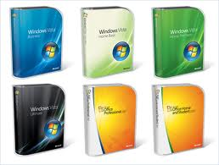
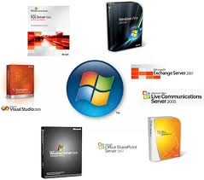
Microsoft products
From the Microsoft windows 1.0 to 8.0

Slide 6
Steve Jobs February 24, 1955 – October 5, 2011 born in San Francisco
Steve was adopted at birth by Paul Reinhold Clara Jobs.
Jobs' attended Monta Loma Elementary school in Mountain View as prankster.
Later attended Cupertino Junior High and Homestead High School.
He then went to Reed Collage in Oregon, but then 6 months later dropped out.
He then became a technician.

Slide 7
Bill Fernandez, was his friend that had the same interests in electronics who also introduced Steve Wasniak.
In 1976 wozniak and jobs formed the company
Was known as the American entrepreneur.
He was CEO and co-founder of the Mac company.
Steve Jobs was board of directors for the Walt Disney company in 2006.
After a power struggle with the board of directors in 1985, Jobs left Apple and founded next.
He was diagnosed with a pancreas cancer.

Slide 8
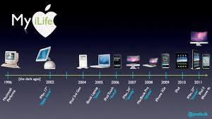
Apple products
From apple 1 computer to the Ipad mini

Slide 9
Thesis statement
Both Steve and Bill did amazing things that will be remembered forever but I think Bill Gates did more for the computing world. Gates is such an intelligent human being. Inventing Microsoft windows has helped us with our everyday life, especially in school and work. Plus Apple uses lots of the programing with Microsoft as well. If his program wouldn’t have been invented we wouldn’t probably wouldn’t be writing on this PowerPoint or at least not right now….

Slide 10
References
http://www.firstpost.com/tech/steve-jobs-vs-bill-gates-who-will-have-the-greater-legacy-52822.html
http://en.wikipedia.org/wiki/Bill_Gates
http://en.wikipedia.org/wiki/Steve_Jobs

